Slide 1
Sales Representative Promotion: Data as a service
NEERAJ REDDY GUNDA

Slide 2
SUMMARY
The pertinent aim of the system is to find out the top 50 company sales representatives with the highest sales . This is done so that they can be promoted to higher ranks. The average sales per year, work consistency, the name of the organization, and the overall work experience will be the core areas of focus..
Secondly, it will help limit the number of promotion applications by the sales representatives to a small number hence saving time and money
In developing the system, multiple machine learning regression algorithms were evaluated and the information collected was stored in the Kubernetes,mongodb. Besides, a simple user interface will be created to help the HR and Managers input data related to sales representatives and obtain the promotion eligibility results.

Slide 3
DEFINITIONS AND TERMINOLOGIES
DaaS- Data as Service
RPO- Recovery Point Objective
RTO- Recovery Time Objective
RAID-Redundant Array of Independent Disks
HR- Human Resource
HTML- HyperText Markup Language
CSS- Cascading Style Sheet
HTTP-Hypertext Transfer Protocol
API- Application Programming Interface
JBO- Just Bunch of Disks

Slide 4
DATA MODEL DESIGN
Type of Data Model
The type of data model used in the sales representative promotion system is relational. This is because the database is built in a un-structured manner. For instance, the sales for each sales representative for four years is determined by work consistency
Data Structures
The conceptual data model shows the relationship of concepts between the sales representatives and the company to aid in predicting promotion eligibility.
A logical data model is also used in showing the relationship existing between the sales representative and the HR department.
Data Integrity Constraints
Error-checking test is conducted in the data transfer and interpretation purposely to measure the ability to identify errors in a data.
The validate input works by verifying the unknown and known data and ultimately validating it to ensure that the data is accurate.

Slide 5
CAPACITY PLANNING
Storage
Based on the data structure and data type, the disk space or storage size needed for the system is 100 gb .The fields include; CSS, average sales for the sales individuals, and 2 records of the performance of the sales individual for the last 4 years.
Data Retention
The data in the system will be retained for 1 year. This is because the system will only be applicable in the company for 1 year and end when the promotion ends.
Network
Based on data access and update, the system needs a network bandwidth of 10 million bits/second (Mbps). This bandwidth will help easy and faster and access of information. 10 million bits/second (Mbps) provides the strongest network for the system.

Slide 6
PERFORMANCE CHARACTERISTICS
One of the key performance goals is providing the best performance for the users by tuning. Another performance goal that the system should meet is ensuring efficient use of resources. Storage, network, memory, and processing should be utilized to ensure the performance of the system is at a high level.
Tuning the system will help inefficient usage of the resources. When the usage of the resources is not balanced, the performance of the Daas system will be altered
Data Structure Performance Tuning
This step will help ensure that the server memory matches the data structure. therefore, this step helps in determining the right primary key for tuning.
Achieving table data and removal of duplicate or unused indexes.
Ultimately, use explain statement to determine how the data structures are executed.

Slide 7
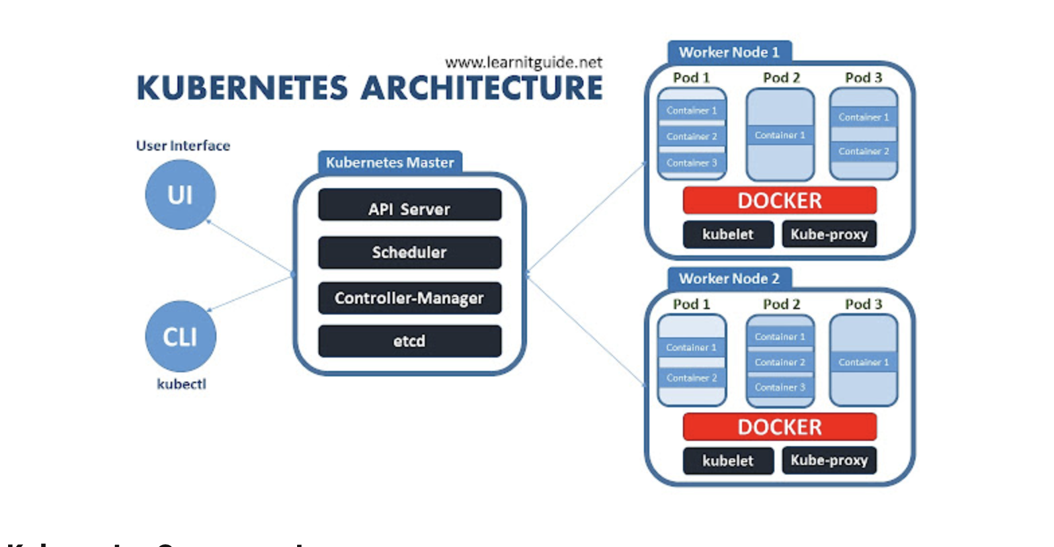
HIGH AVAILABILITY DESIGN
High Availability Requirements
The desired recovery point objective (RPO) for the system is 24 hours. This means that the system is prepared for backup after every 24 hours.
On the other hand, the desired recovery time objective (RTO) for the system is 24 hours. 6 hour RTO will be enough for the system to recover the lost data and resume its functions.
High Availability Implementation
The system is designed in a manner that it is able to meet the Recovery Point Objective (RPO) and the Recovery time objective (RTO). Active standby clustering is implemented to ensure high availability configuration. To manage high availability configuration, the system will be using containerization and Kubernetes.
The key aspects of Kubernetes that is focused on when designing the system include:
K8s workloads, Kubernetes Secrets
Kubernetes Service Accounts
Kubernetes Metrics Service (Metrics API)
Pod Autoscaling.

Slide 8
DATA SECURITY
Authentication
The sale representative promotion system will rely on the key security terms to ensure that only the authorized users are capable of accessing the organization's information . First, the system approves authorization for logical access of the information in a unique manner. To authenticate the users the system will uses passwords. However, only encrypted representations of the password are used.
Encryption
Encryption is fundamental both for data at rest and data in transit. The key objective of the system is to maintain information integrity and confidentiality. NIST FIPS 140-2 is used by the system to validate cryptographic operation during encryption.

